Slide 1
A UNIFIED COMPARATIVE FRAMEWORK FOR CLASSICAL AND LEARNING-BASED IMAGE RESTORATION: DEHAZING, DEBLURRING, AND DENOISING
G56: Jiangrong Liu, Tiancheng Chen, Xinli Xiang

Slide 2
Contents
1
Problems / Challenges
2
Methods
3
Simulation Results
4
Comparison & Discussion
5
Future work & Conclusion

Slide 3
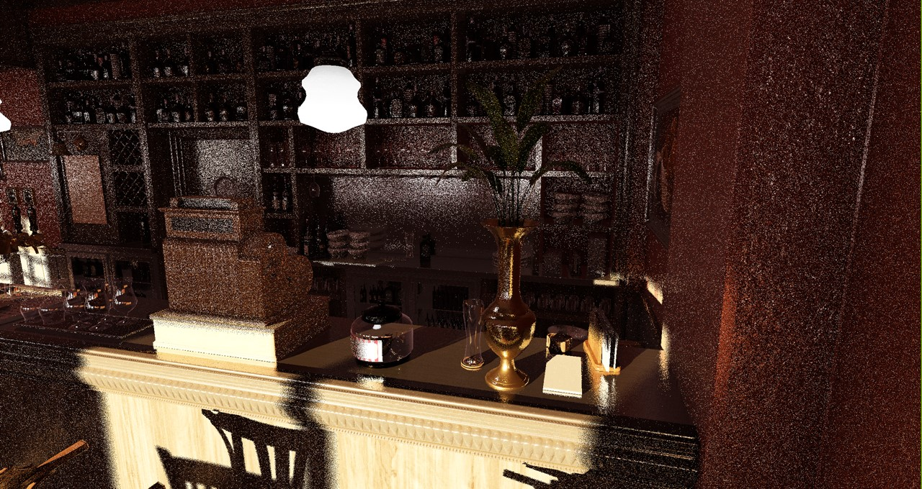
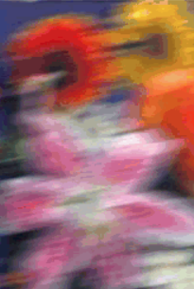

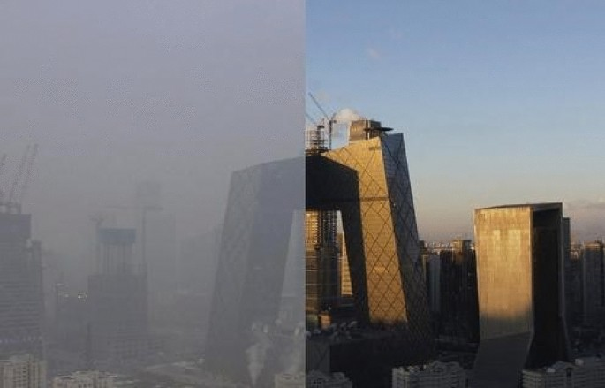
Problems / Challenges （School situation）
Challenge 1: Dehazing
Outdoor/indoor images often suffer from haze due to scattering of light by atmospheric particles.
Haze reduces visibility, contrast, and color fidelity
Challenge 2: Deblurring
The blur is typically caused by camera shake, defocus, and moving objects
Mainly focus on blind deblurring
Challenge 3: Denoising
Images suffer from sensor noise, especially under low light and high ISO.
sensor-induced distortions
sharp for interpretable structures
scene visibility & color fidelity

Slide 4
Methods
Challenge 1: Dehazing
1. Dark Channel Prior (DCP)
Physics-based, no training required
Uses dark channel assumption to estimate transmission map and atmospheric light
Strong generalization to real-world haze
2. AOD-Net (Deep Learning)
Lightweight CNN trained on synthetic haze
Directly learns mapping from hazy image to clean image
Fast inference, good performance on synthetic data
Challenge 2: Deblurring
1. Unnatural L0 Sparse Representation
Sharpens images by enforcing sparsity on gradient magnitudes.
Produces an "unnatural representation" that stabilizes kernel estimation.
2. Internal Patch Recurrence
Exploits the fact that sharp images exhibit strong cross-scale patch similarity.
Restores fine structures that sparsity-based models often lose by matching patches between an image and its downscaled version.
Challenge 3: Denoising.
1. Multi-Wavelet Shrinkage (Classical)
DWT decomposition + soft-thresholding.
Uses multiple wavelets (db2/db4/sym8) for robustness.
2. SVR Denoising (Classical Learning)
Patch-based regression using Support Vector Regression.
Learns nonlinear mapping from noisy patches to clean intensities.
Requires patch extraction + model training.
3. DnCNN (Deep Learning)
Residual CNN predicting noise component directly.
Strongest performance expected.
Requires dataset, GPU training, and careful tuning.
State-of-the-art baseline for final comparison.

Slide 5
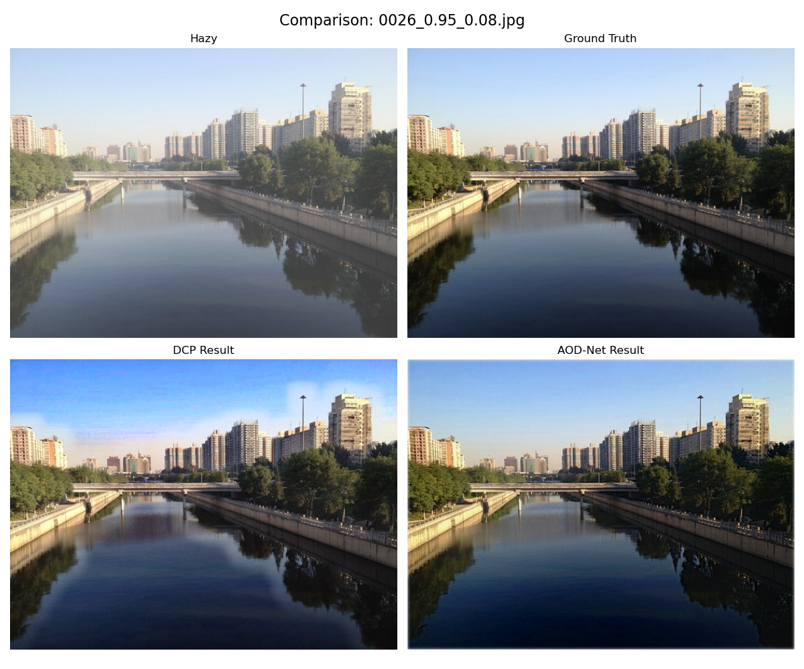
Simulation results
Challenge 1: Dehazing
Dataset: RESIDE (with ground truth, to evaluate PSNR / SSIM) and O-HAZE + self-captured (no ground truth, to evaluate NIQE / BRISQUE)

Slide 6
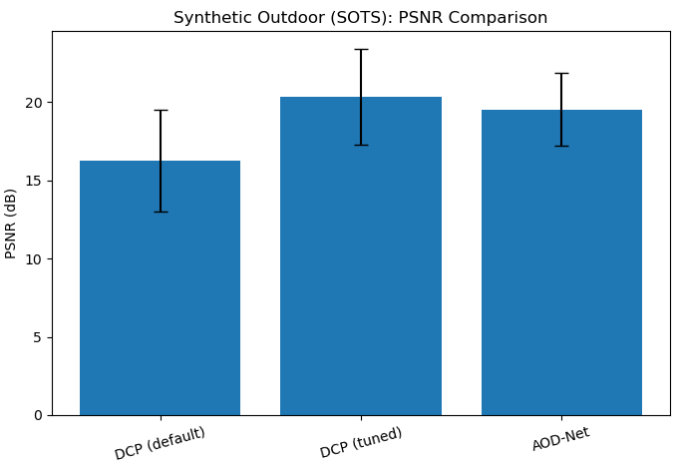
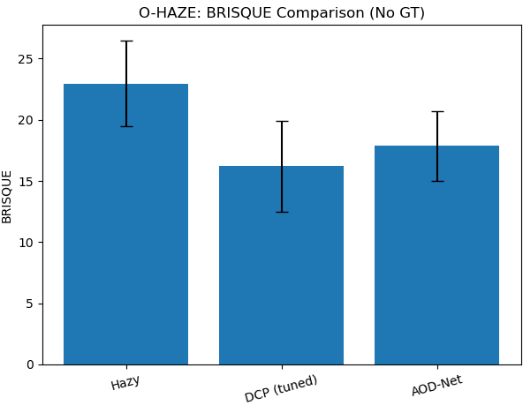
Comparison & Discussion
Challenge 1: Dehazing
Observation:
DCP restores strong contrast and sharp details, but introduces slight color oversaturation and halo artifacts near edges.
AOD-Net produces a more natural color tone and smoother transitions, though fine details are slightly less sharp than DCP.
Overall, AOD-Net better preserves global color fidelity, while DCP emphasizes local contrast at the cost of minor visual artifacts.
Statistics:
On synthetic outdoor haze, default DCP method achieved lower PSNR and SSIM, but tuned DCP slightly outperformed after parameter optimization.
On real-world haze (O-HAZE), DCP demonstrates better perceptual quality according to no-reference metrics.
Fine-tuning played an important role in optimization.

Slide 7
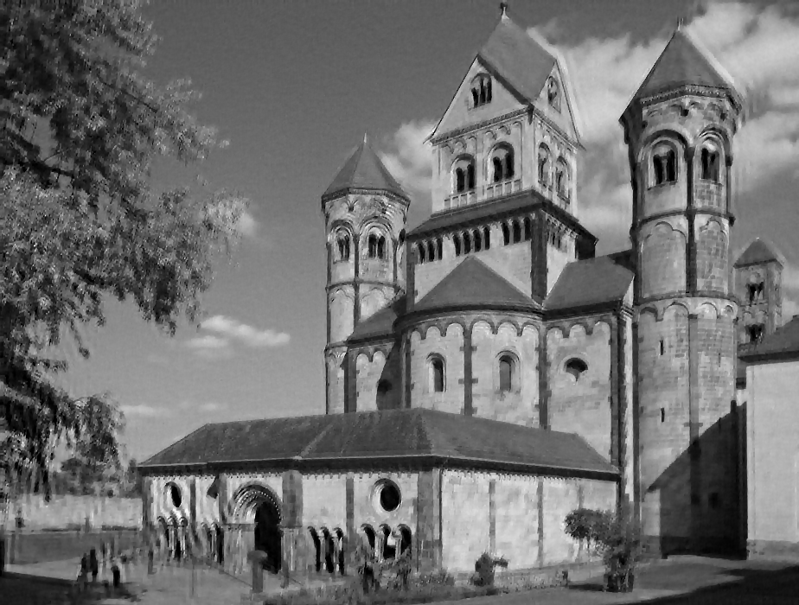
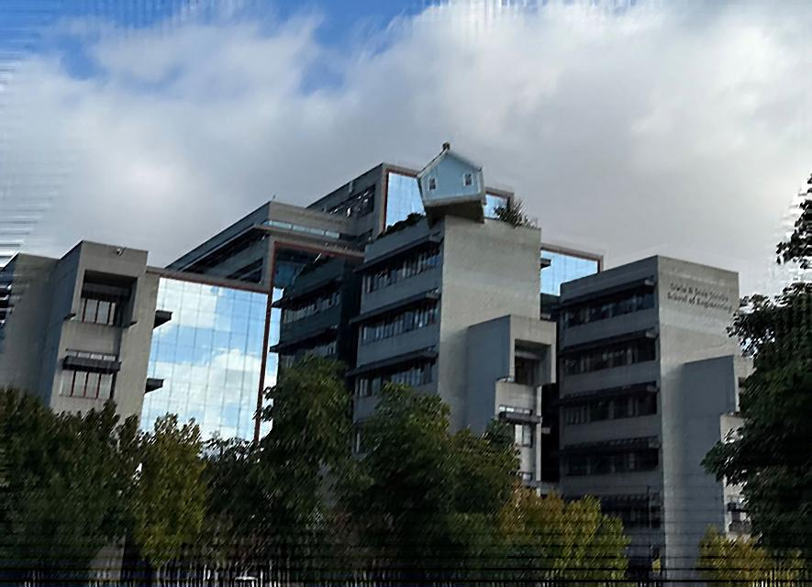
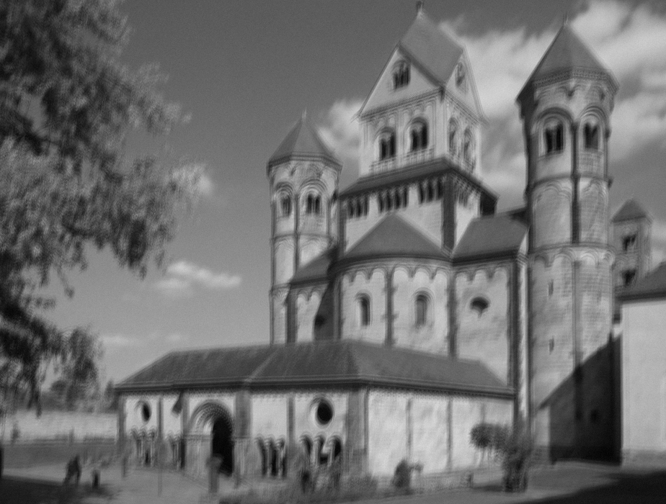
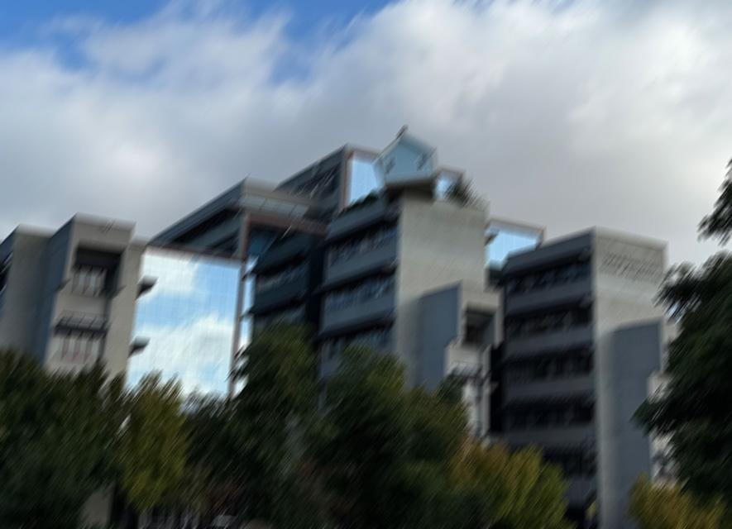

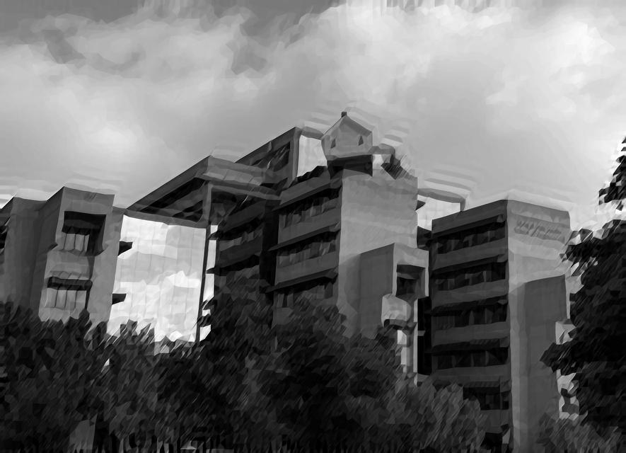
Simulation results
Challenge 2: Deblurring
Sun et al. dataset., 10 ground-truth image * 8 blur kernel
Xu et al.’s method: PSNR 26-31dB, SSIM 0.84-0.89
Michaeli et al.’s method: PSNR 26-33dB, SSIM 0.81-0.88
Real-world. dataset., photos shot by us
Use Naturalness Image Quality Evaluator (NIQE) as a no-reference metric

Slide 8
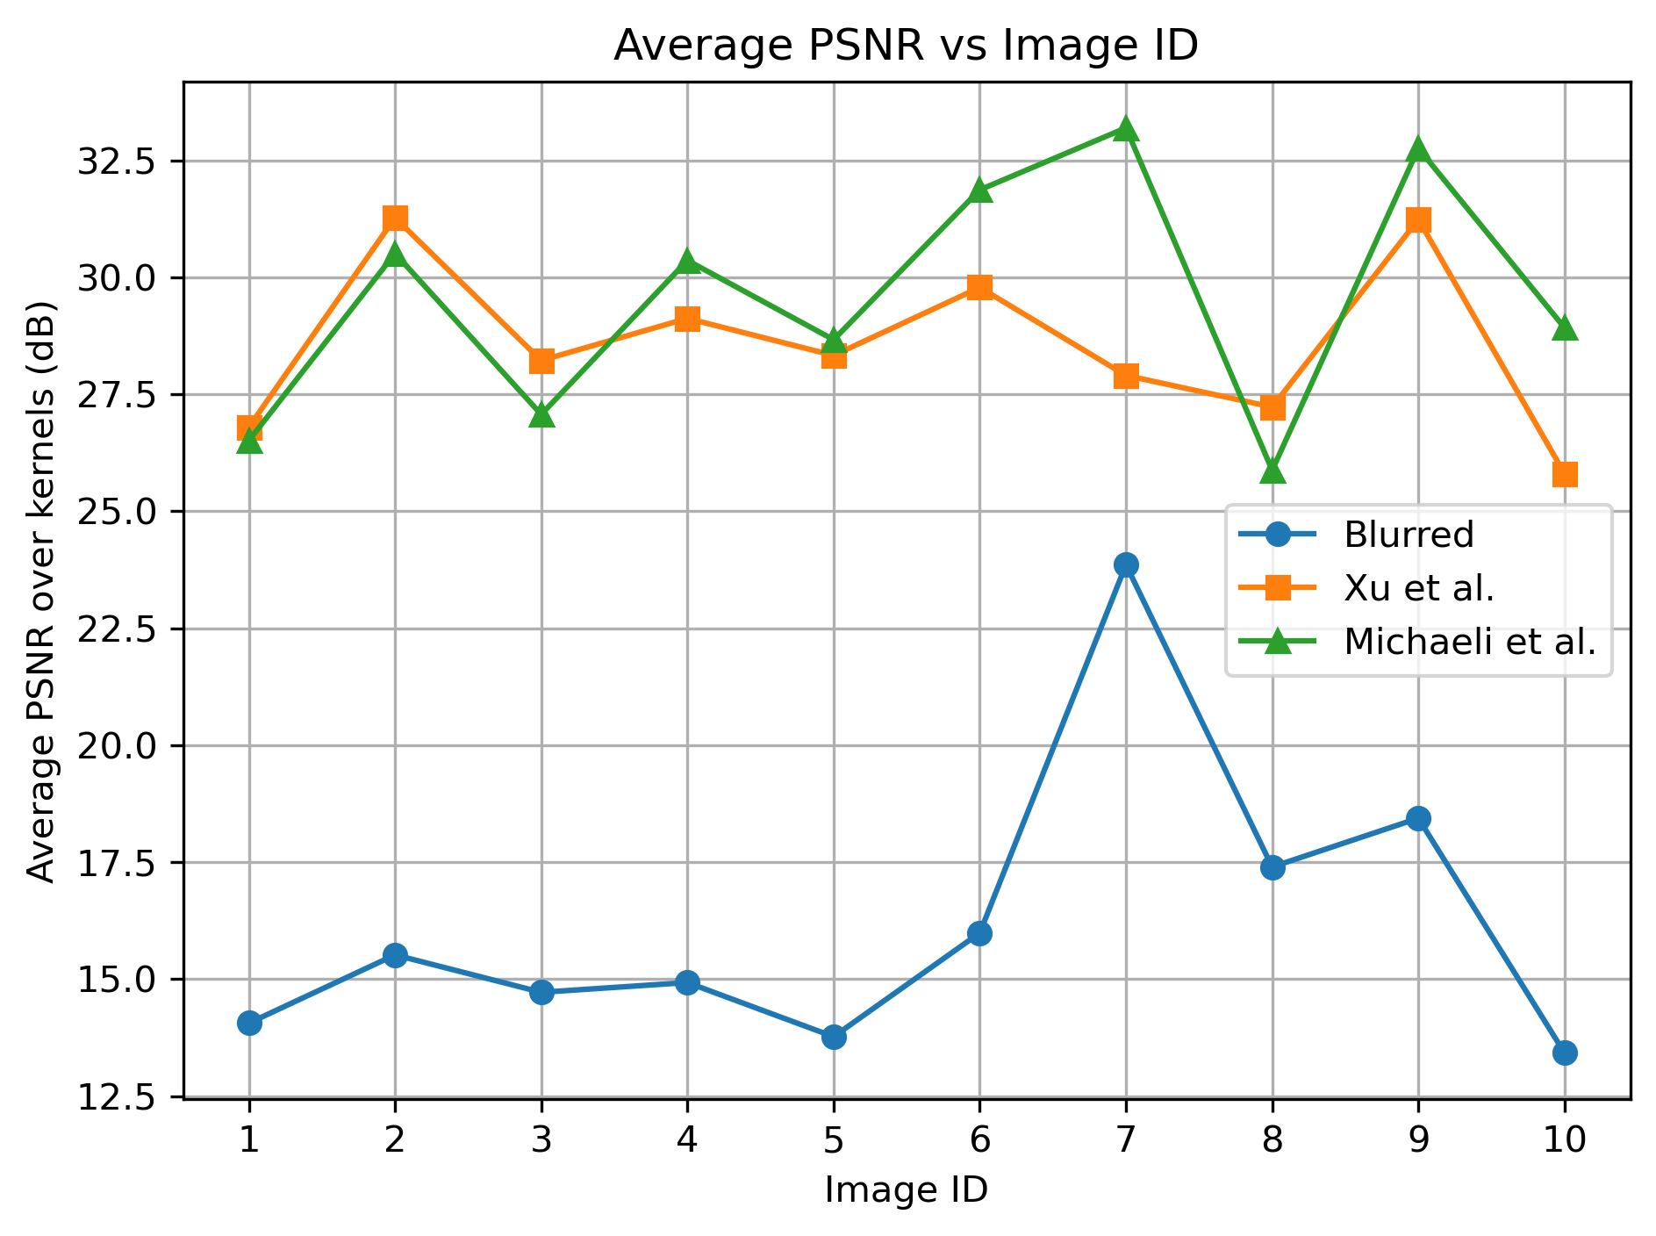
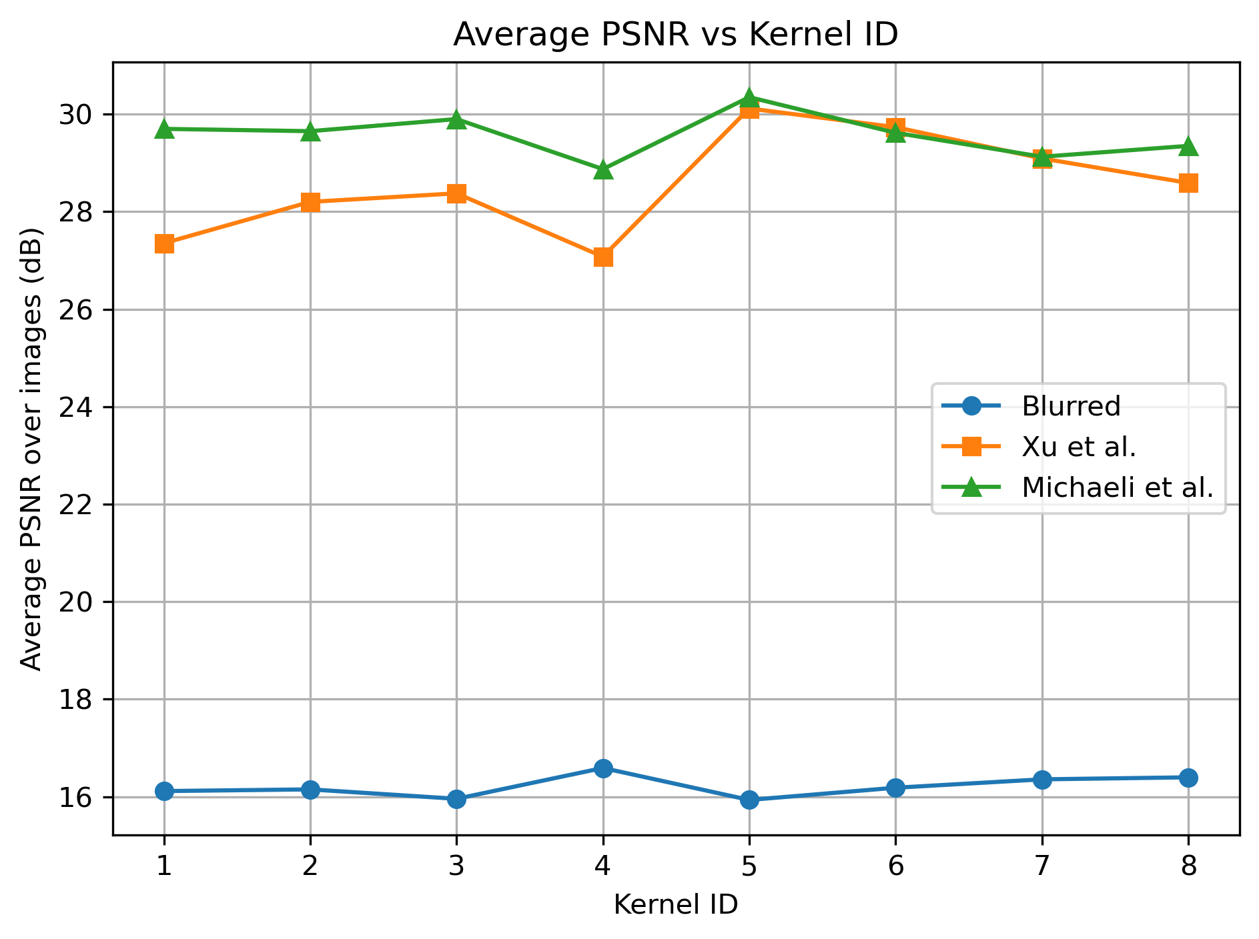
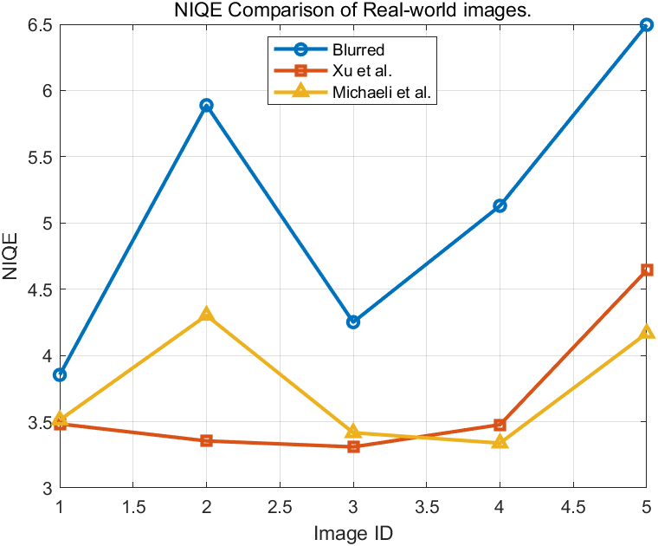
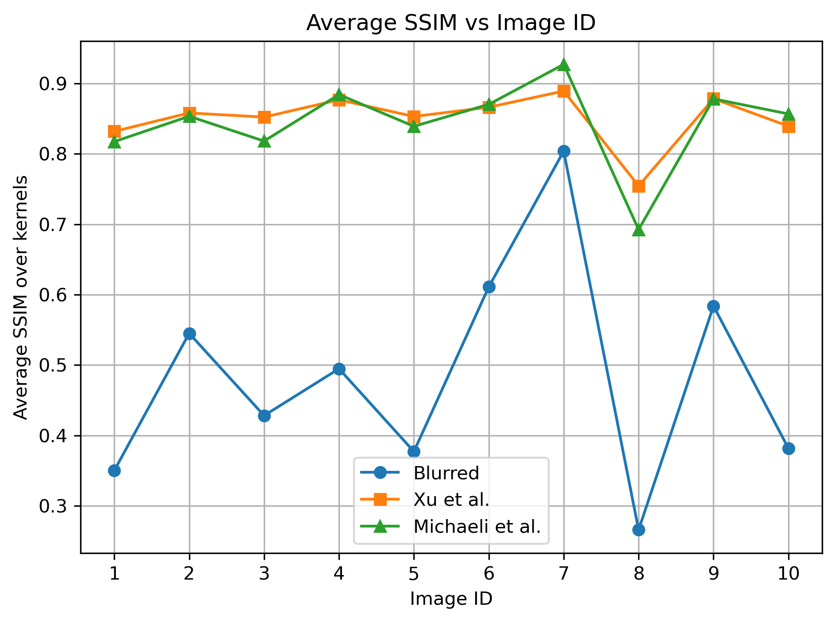
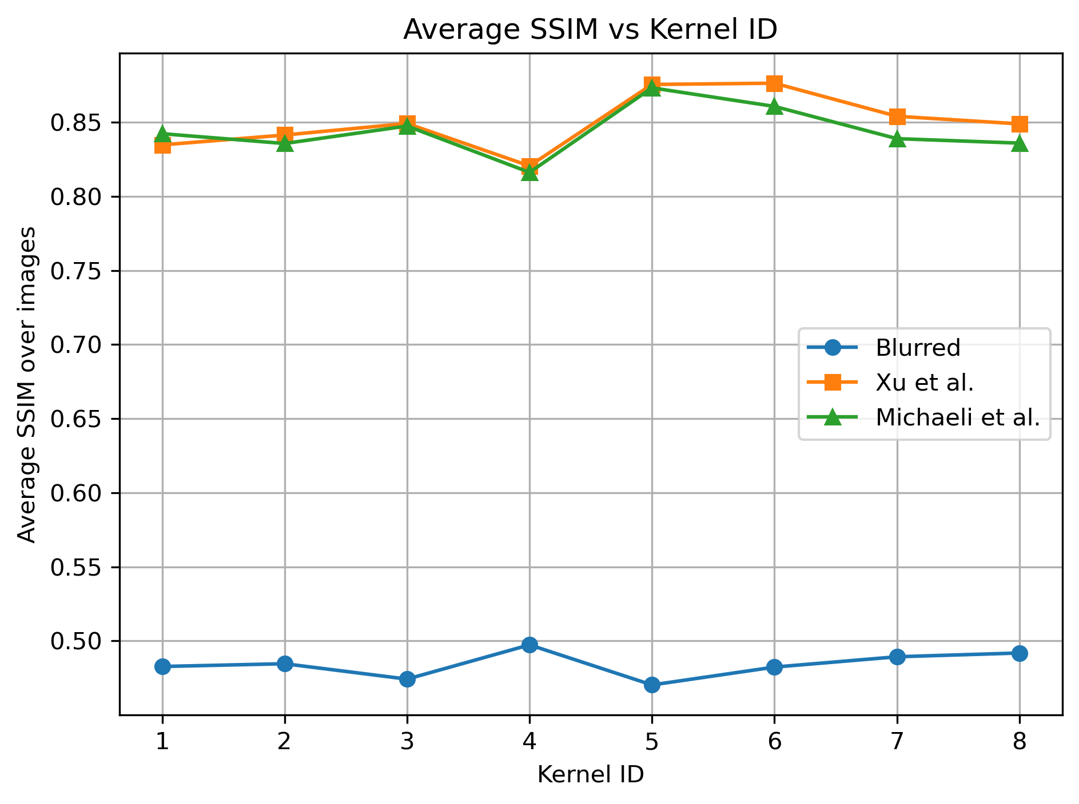
Comparison & Discussion
Challenge 2: Deblurring
Xu et al.’s method: stable and robust, particularly on defocus blur.
Michaeli et al.’s method: excels at recovering textures and performs better with motion blur.

Slide 9
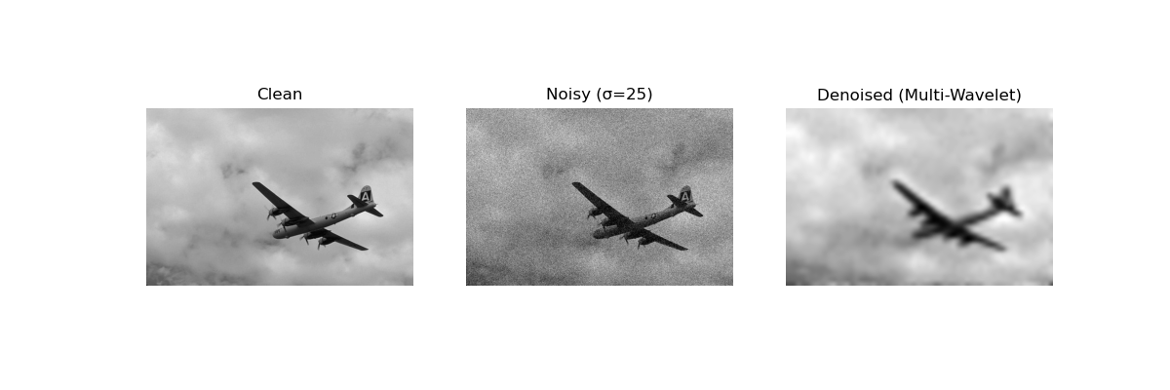
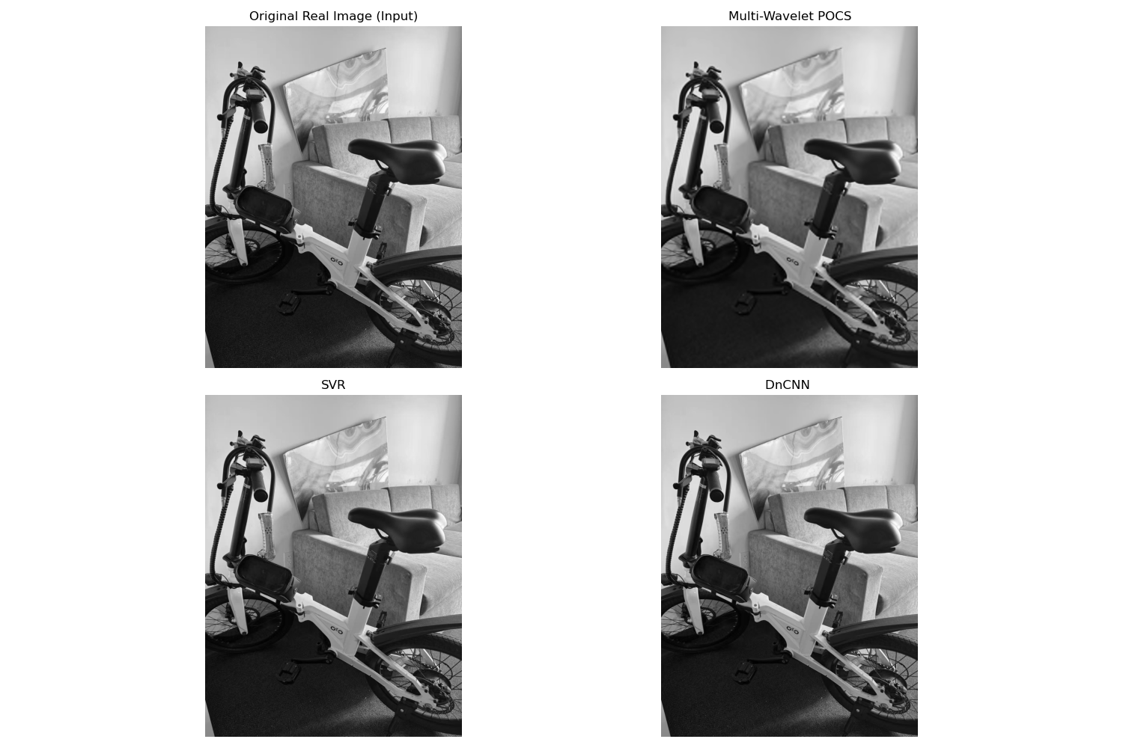
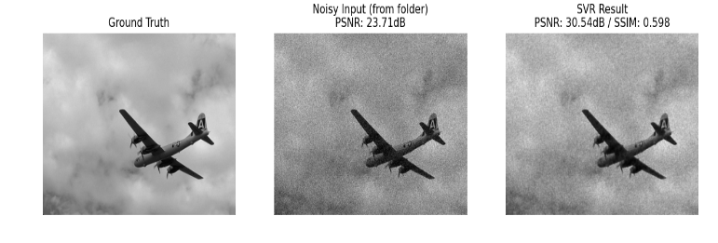
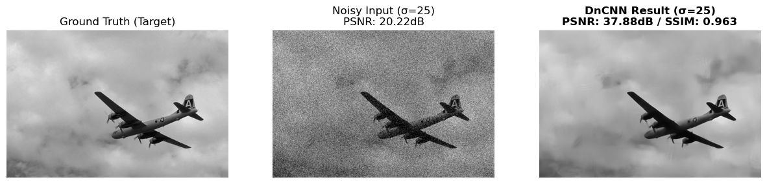
Simulation results
Challenge 3: Denoising（Noise Level σ = 25）
Zhang‘s BSD64 dataset
Real-world dataset: photo for my bicycle in gradhousing

Slide 10
Comparison & Discussion
Challenge 3: Denoising
Method | Noise σ | Noisy PSNR (dB) | Denoised PSNR (dB) | SSIM
Wavelet | 15 | 27.21 | 21.90 | 0.504
Wavelet | 25 | 22.34 | 21.77 | 0.499
Wavelet | 50 | 17.93 | 21.36 | 0.485
SVR | 15 | 28.12 | 32.28 | 0.670
SVR | 25 | 23.71 | 30.71 | 0.609
SVR | 50 | 17.82 | 28.19 | 0.504
DnCNN | 15 | 26.55 | 40.56 | 0.981
DnCNN | 25 | 20.22 | 37.88 | 0.963
DnCNN | 50 | 17.80 | 34.03 | 0.923
Wavelet
Traditional baseline
Lowest PSNR and SSIM
Limited structural detail preservation
SVR
Learning-based improvement over wavelet
PSNR gain of 4–10 dB
Best structure recovery at low noise (SSIM = 0.67)
DnCNN
Clearly superior performance
Near-perfect structure recovery
SSIM = 0.963 at σ = 25
19.66dB!

Slide 11
Conclusion & Future Work
Challenge 1: Dehazing
Challenge 2: Deblurring
Challenge 3: Denoising
Compared classical and deep dehazing on synthetic and real data.
Both excelled, while deep learning method better preserves global color fidelity for real haze.
Future Work
Fine-tuning: Real-world haze data → Optimal parameters
Stronger Models: Attention-based dehazing networks
Both methods effectively enhance blurred images
Their complementary strengths provide valuable insight for future deblurring research.
Future Work
Blur Diversity ↑: More challenging blur types
Efficiency ↑: Reduced computation
Hybrid: Classical priors + Deep learning
Learning-based methods outperform wavelet denoising.
SVR balances performance and complexity.
DnCNN delivers the best quality at higher cost.
Future Work
Lightweight Models → Efficient / Compressed Networks ↓ Cost
Real-Noise Generalization → Gaussian → Real-world / Non-Gaussian

Slide 12
Thank You

